Slide 1
Title: Automated Classification Of Gastrointestinal Tract Diseases Using Hybrid Model
Under the Guidance of Presented by – Batch 29
Mrs. D. Vijaya sri 23761A1267 – A. Anuradha
Sr. Asst. Professor 23761A12C8 – U. Pravallika
23761A1290 – J. Gopi chandu

Slide 2
domain:
Artificial Intelligence (AI) – Deep Learning: Enables computers to perform tasks that normally require human intelligence. Deep Learning, a branch of AI, uses neural networks to automatically learn features from medical images and improve disease classification.

Slide 3
ABSTRACT:
Gastrointestinal diseases can cause serious health problems if they are not identified at the right time. In recent years, many deep learning methods have been developed to classify these diseases from endoscopic images, but most of them use a single type of model for feature extraction. As a result, some important image information may not be captured effectively. This project extends the existing work by combining a CNN-based model with a transformer-based model to make better use of the information present in endoscopic images. The proposed approach is expected to learn both detailed and overall image features, which can help improve disease classification.

Slide 4
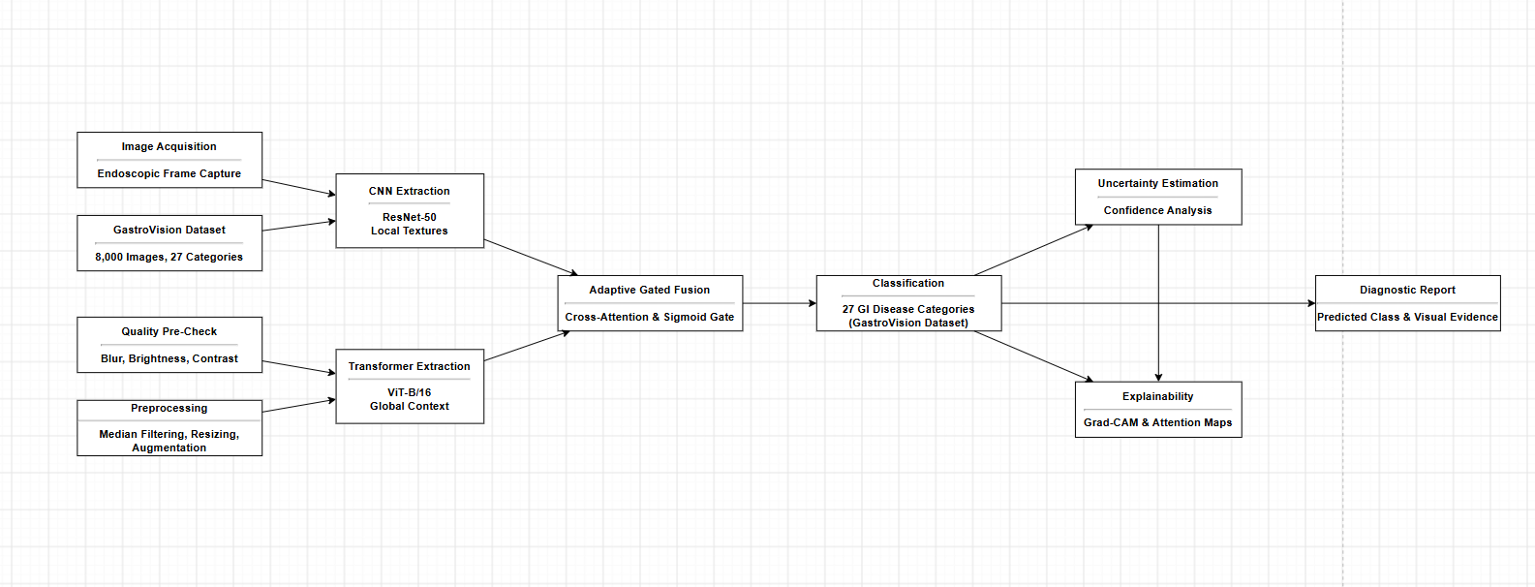
System design

Slide 5
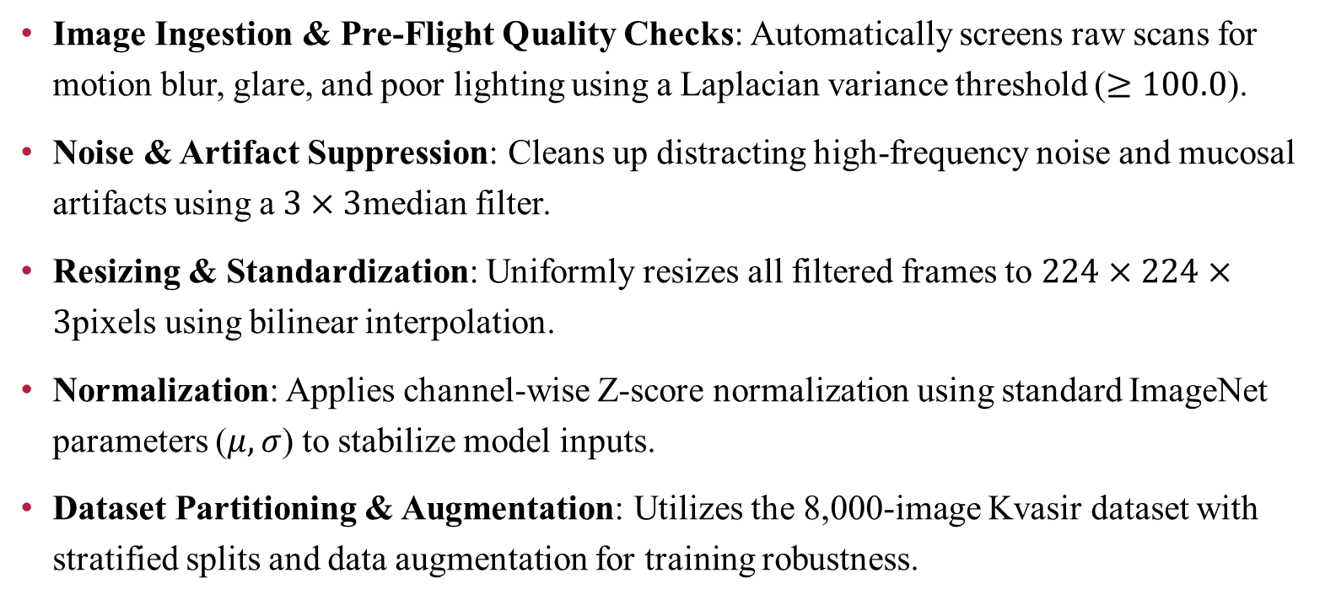
Implementation
Image Ingestion & Pre-Flight Quality Checks: Automatically screens raw scans for motion blur, glare, and poor lighting using a Laplacian variance threshold ($≥100.0$).
Noise & Artifact Suppression: Cleans up distracting high-frequency noise and mucosal artifacts using a $3×3$median filter.
Resizing & Standardization: Uniformly resizes all filtered frames to $224×224×3$pixels using bilinear interpolation.
Normalization: Applies channel-wise Z-score normalization using standard ImageNet parameters ($μ,σ$) to stabilize model inputs.
Dataset Partitioning & Augmentation: Utilizes the 8,000-image Kvasir dataset with stratified splits and data augmentation for training robustness.

Slide 6
EXISTING SYSTEM:
Uses CSCG-ResNet for gastrointestinal image feature extraction.
M-MGO selects important features and removes redundant features.
QI-TabNet performs the final disease classification.
Uses Kvasir v1 + v2 with 8 gastrointestinal categories.
Reported accuracy: 96.75%.
Flow:
Image → CSCG-ResNet → M-MGO → QI-TabNet → Disease Class

Slide 7
DRAWBACKS OF EXISTING SYSTEM:
The existing model mainly depends on a CNN-based ResNet architecture for extracting image features.
CNNs are effective at learning local features such as edges, textures and patterns, but they have limitations in capturing long-range relationships between different regions of an image.
The system contains multiple processing stages — CSCG-ResNet, M-MGO and QI-TabNet, making the overall architecture relatively complex.
Requires additional feature optimization and classification stages.
the multi-stage architecture introduces additional computational complexity.

Slide 8
PRoPOSED SYSTEM:
Develop a CNN–Transformer hybrid for GI disease classification.
Combine the strengths of CNNs and Transformers.
CNN extracts local features such as textures, shapes, and patterns.
Transformer captures global features and contextual relationships.
Evaluate ResNet-50 as CNN backbones.
Evaluate ViT-B/16 as Transformer backbones.
Apply Adaptive Gated Cross-Attention to combine local and global features.
Use the fused features for final disease classification.

Slide 9
ADVANTAGES OF PRoPOSED SYSTEM:
Dual-Feature Capture: Combines CNN local textures with Transformer global context.
Dynamic Fusion: Uses an adaptive sigmoid gate instead of static concatenation.
Uncertainty Guardrails: Flags low-confidence predictions to prevent unverified decisions.
Clinical Explainability: Integrates Grad-CAM and attention maps to highlight diagnostic regions.
Automated Preprocessing: Screens blur and filters mucus artifacts before analysis.

Slide 10
ADVANTAGES OF PRoPOSED SYSTEM:
CNN captures local features like edges, textures, shapes, and disease patterns.
Transformer captures global features and relationships between different image regions.
Combines local and global information for better disease classification.
Avoid unnecessary layers and complex operations.
Requires less memory and computational power

Slide 11
Literature survey
TITLE | YEAR | AUTHOR | MODELS USED | KEY CONTRIBUTION | ACCURACY
An Improved ResNet-Based Deep Learning Model with Modified Mountain Gazelle Optimization for Gastrointestinal Disease Classification | 2026 | Harshitha E.S. Narmadha G. Sakthivel B. Muneeswari B | CSCG-ResNet (Channel-Spatial Context Gating ResNet), Modified Mountain Gazelle Optimizer (M-MGO), and Quantum-inspired Adaptive TabNet (QI-TabNet) | Proposed an improved ResNet-based model combined with a Modified Mountain Gazelle Optimization algorithm to enhance feature optimization and improve the classification of gastrointestinal diseases. | 96.75%
GastricNet: an efficient and lightweight deep neural network in mobile edge computing for gastrointestinal disease detection | 2026 | Sohaib Asif Rongbiao Ying Jinjie Qu Vicky Yang Wang Jun Yao Dong Xu | GastricNet (incorporating Lite-ResB, ConvMixer, Squeeze-and-Excitation, and Hypercolumn technique), compressed via Knowledge Distillation (KD) using MobileNetV2 as teacher | Proposed GastricNet, a lightweight and efficient deep learning model for gastrointestinal disease detection, designed to reduce computational complexity and support deployment in mobile edge computing environments. | 98%

Slide 12
Literature survey
TITLE | YEAR | AUTHOR | MODELS USED | KEY CONTRIBUTION | ACCURACY
Enhanced DINOv2-Based Framework for Multi-Class Gastrointestinal Abnormality Classification in Capsule Endoscopy | 2025 | Manav Anand, Pradneya Prabhudesai, Pranav Kumar, Geeta Sikka, and Arjun Singh Rawat | DINOv2 ViT-B/14 encoder, lightweight classifier head (dense layers with ReLU and Softmax), and Adam optimizer | It uses a frozen pre-trained Vision Transformer (DINOv2) with a lightweight classification head to highly accurately and efficiently categorize ten distinct gastrointestinal abnormalities from video capsule endoscopy images without the need for extensive fine-tuning | 93.31%
A Novel Random Forest-SMOTE Framework With Polynomial Feature Engineering for Early Detection of Gastrointestinal Disorders | 2025 | Parvez Rahi, Mohammad Rashid Hussain, Salem Alqahtani, Mohammad Husain, Ajay Pal Singh, and Inderjeet Singh | Random Forest (RF), Synthetic Minority Oversampling Techni-que(SMOTE), GridSearchCV, Polynomial Feature Engineer-ing, CNN, LightGBM, and TabNet | It introduces a highly accurate, non-invasive system that predicts gastrointestinal diseases based on a patient's tabular clinical, lifestyle, and genetic symptom data rather than relying on images | 96.61%

Slide 13
DATASET INFORMATION
GastroVision Dataset
8,000 GI endoscopy images with 27 classes
Covers upper and lower GI tract findings
Includes normal and pathological conditions
Images collected from hospitals in Norway and Sweden
Expert-annotated by GI endoscopists
Used for automated GI disease classification

Slide 14
CONCLUSION
The proposed hybrid CNN–Transformer model provides an effective approach for gastrointestinal disease classification using capsule endoscopy images. By combining local and global feature extraction, it overcomes the limitations of the existing single-model approach. The use of the Gastro Vision dataset enables reliable model training and evaluation. This approach is expected to improve disease classification and support faster, more accurate clinical diagnosis.

Slide 15
Thank you..

